Slide 1



Celebal Internship Presentation
Project Name : Ratio Of Cost Of Job
Group Name : SQL-2
Submitted By :
Gaurav Mishra (Group Leader)
(PCE18CS057)
Rishabh Jain (PCE18CS133)
Nupur Khatri (PCE18CS107)
Ashutosh Tiwari (PCE18CS034)
Ishika Solanki (PCE18CS067)
Submitted To:
Hemant Pareek Sir
(JIET)

Slide 2
Objective
To Display Ratio of Cost of Job Family in percentage by India and International.

Slide 3
Target Audience
Data Administrator:
It need to handle all facets of managing Microsoft SQL Server ranging from installation and patching to creating databases to managing permissions that allow users to use the databases. However, more than anything, they are responsible for protecting the data and maintaining performance levels.
Database Developers:
These are primarily responsible for creating and implementing computer databases. They determine the best database management system for a particular client, as well as test database programs for efficiency and performance and troubleshoot and correct problems.
BI Professionals:
They leverages software and services to transform data into actionable insights that inform an organization’s strategic and tactical business decisions. BI tools access and analyze data sets and present analytical findings in reports, summaries, dashboards, graphs, charts and maps to provide users with detailed intelligence about the state of the business.

Slide 4

Oracle SQL
Oracle SQL:
Structured Query Language (SQL) is the set of statements with which all programs and users access data in an Oracle database. Application programs and Oracle tools often allow users access to the database without using SQL directly, but these applications in turn must use SQL when executing the user's request.
Example: Once the table is created it is possible to connect to it and use it for data-driven testing:
1. Click on Add from Data Sources menu:
2. In the Create new data source dialog - for Data Source Types choose Database

Slide 5
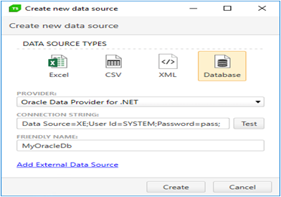
Oracle SQL

Slide 6
Oracle SQL
3. For Provider, select Oracle Data Provider for .NET
4. Here's an example for Connection String:
It is possible to create many different connection strings.
5. Customize the Friendly Name as desired.
6. Click Create and the new data source should appear in the Data Sources list.
When a test is bound to this data base the table to be used will be specified:

Slide 7
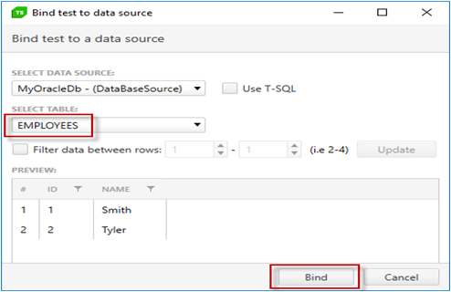

Slide 8

Technology Used
SQL
Server

Slide 9
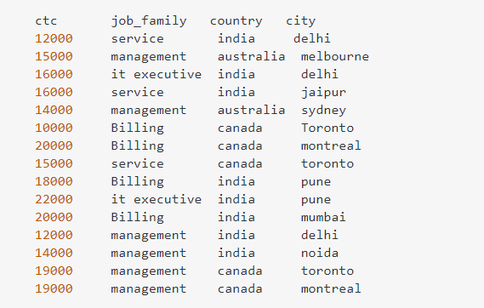
Project Demonstration
We have data table as:

Slide 10
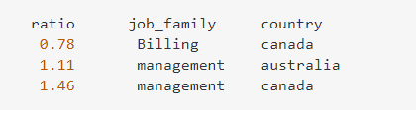
Project Demonstration
Now I want ratio of ctc of each service type internationally to India.
Example: Desired Output
Because Billing total ctc of Canada is 30000 and ctc for billing in India is 38000
so ratio is 0.78 Management ctc total in Australia is 29000 and in India is 26000
so ratio is 1.11 Management total is 38000 in Canada and in India is 26000 so ratio is 1.46
Select job_family, country,
sum(ctc) * 1.0 / sum(case when country = 'India' then sum(ctc) end) over
(partition by job_family) as ratio
from t group by job_family, country;

Slide 11
Future Scope
SQL is a massive technology. The future scope of being an SQL Developer it is not just limited to Computer Science, but you can see it revolving around Retail, Finance, Healthcare, Science & Technology, Public Sector, in short everywhere. All organizations need a database for the storage of their data.

Slide 12
Conclusion
The breadth and scope of the SQL commands provide the capability to create and manipulate a wide variety of database objects using the various CREATE, ALTER, and DROP commands.
Those database objects then can be loaded with data using commands such as INSERT. The data can be manipulated using a wide variety of commands, such as SELECT, DELETE, and TRUNCATE, as well as the cursor commands, DECLARE, OPEN, FETCH, and CLOSE.
Transactions to manipulate the data are controlled through the SET command, plus the COMMIT and ROLLBACK commands. And finally, other commands covered in this chapter include those that control a user’s access to database resources through commands such as GRANT and REVOKE.

Slide 13

Thank You !!

